Slide 1

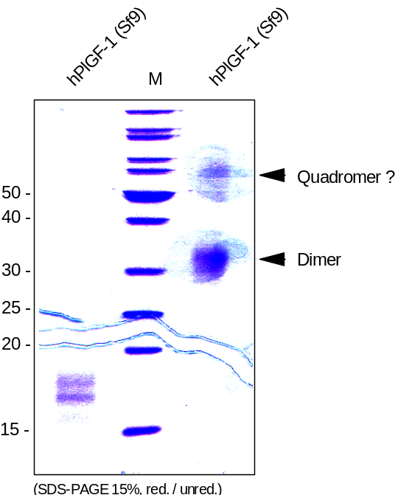
Reliatech GmbH
Recombinant human PlGF-1
(Cat #300-015S / 300-015 / 300-016)
Fig. 1: SDS-PAGE analysis of recombinant human PlGF-1 produced in insect cells. Samples were loaded in 15% SDS-polyacrylamide gel under reducing and non-reducing conditions and stained with Coomassie blue.
http://www.reliatech.de / orders@reliatech.de

